Slide 1

Hardening C/C++ Programs Against Errors & Attack
Emery Berger
University of Massachusetts
joint work with Gene Novark, Vitaliy Lvin (UMass), Ben Zorn (Microsoft Research)

Slide 2

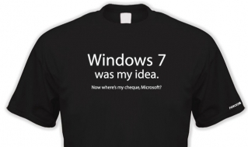
DieHard: Probabilistic Memory Safety for C/C++ Programs [PLDI 2005]
Direct inspiration for Windows 7’s Fault-Tolerant Heap (2009)

Slide 3


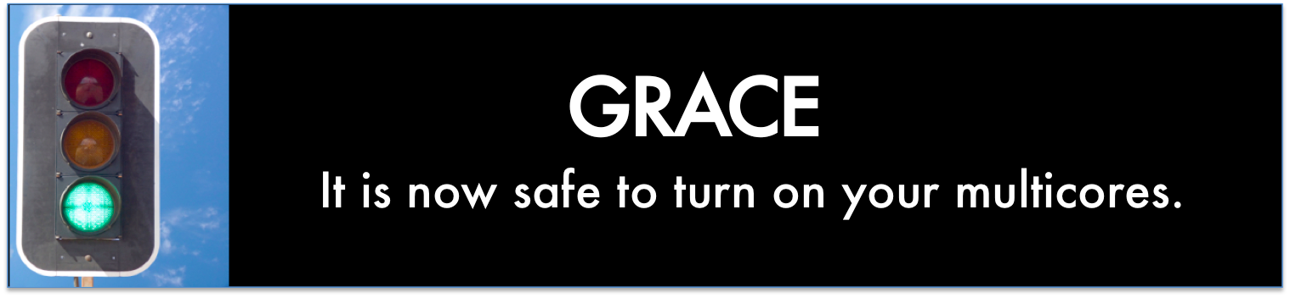
DieHard: Probabilistic Memory Safety for C/C++ Programs [PLDI 2005]
Exterminator: Automatically Correcting Memory Errors with High Probability [PLDI 2007, CACM 2008]
Archipelago: Trading Address Space for Reliability and Security [ASPLOS 2008]
Grace: Safe Multithreaded Programming for C/C++ [OOPSLA 2009]

Slide 4

DieHarder: Securing the Heap [ccs 2010]

Slide 5
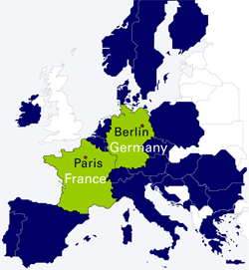

Slide 6


Slide 7


Slide 13
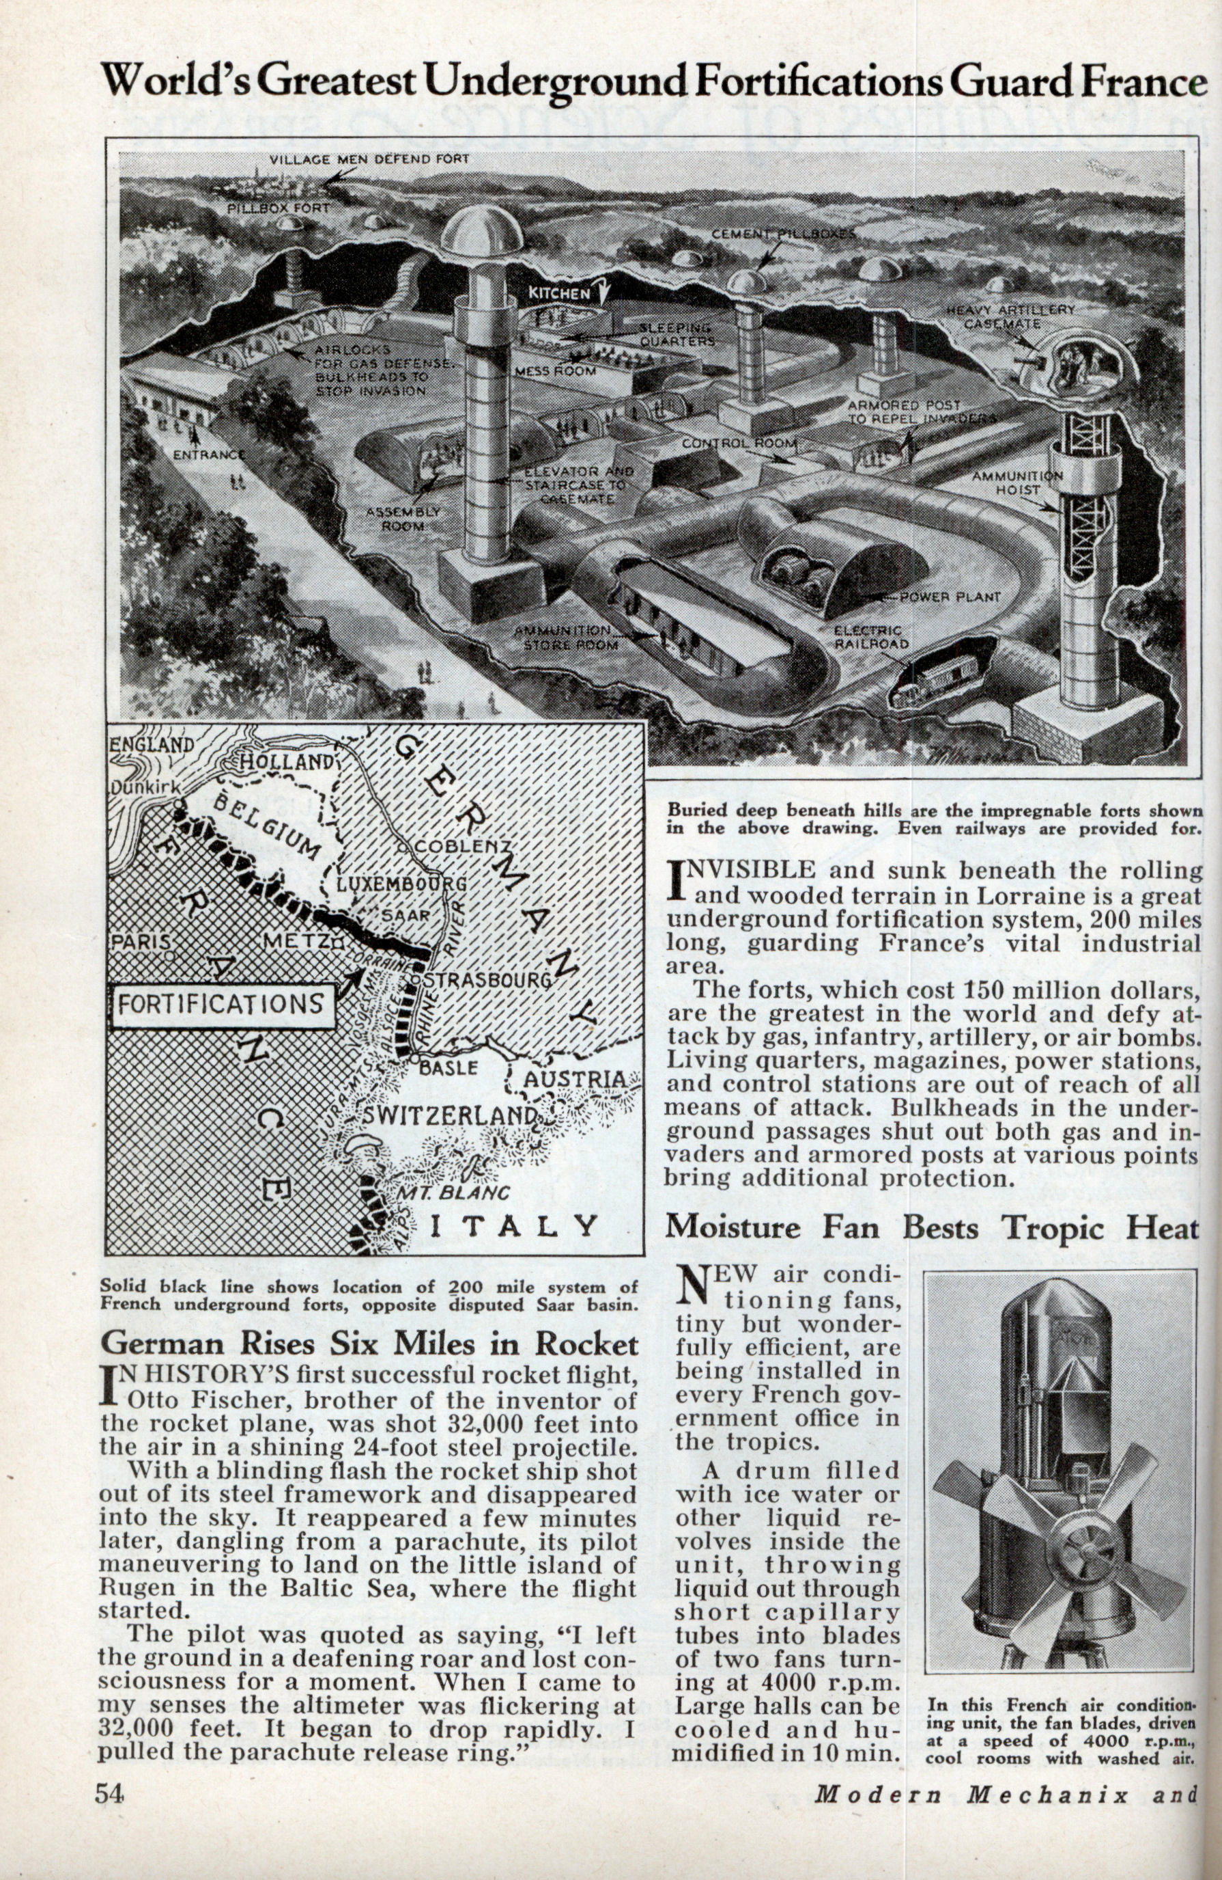

Slide 14
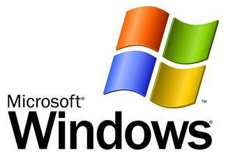
Notes:
I mean, Windows

Slide 17
Notes:
So the big question between counterattacks & the next attack is…

Slide 18
got security?

Slide 19
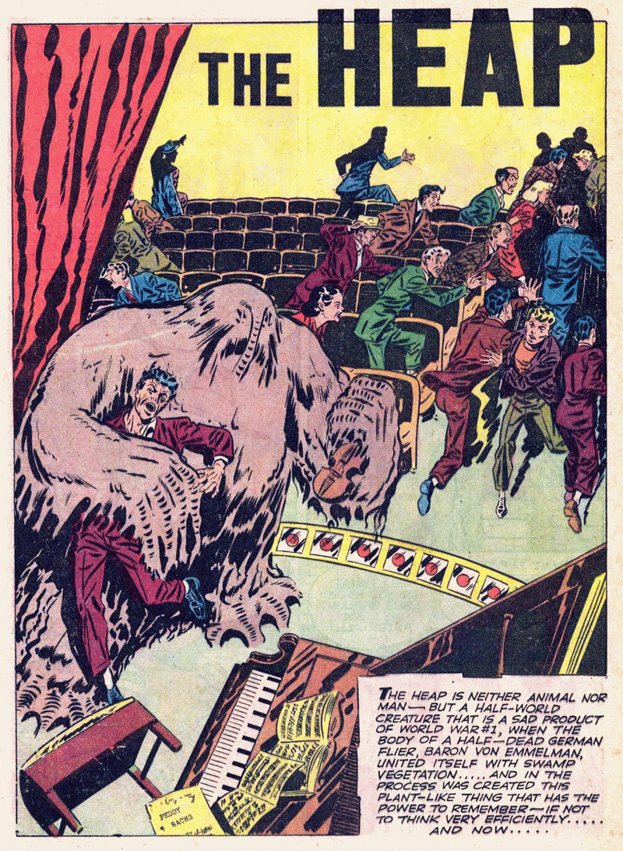
Notes:
Today we are focusing on the heap – a clear threat

Slide 20
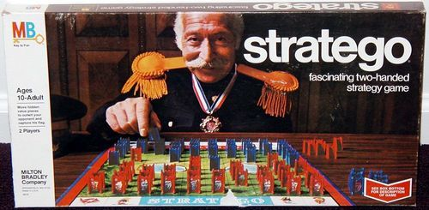
Notes:
Rather than talk technical about the heap internals - stratego

Slide 21
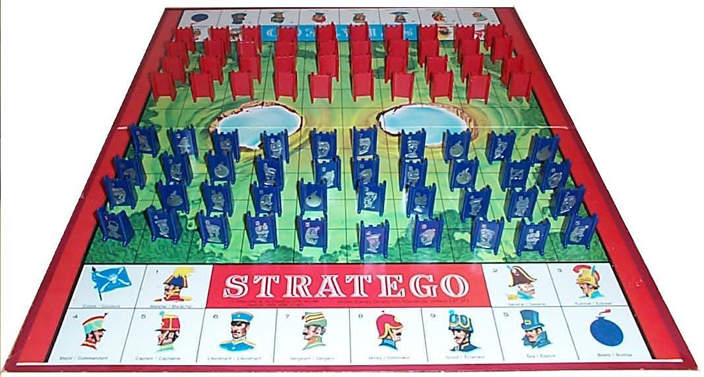
Notes:
If you haven’t played, here’s the way it works…

Slide 22
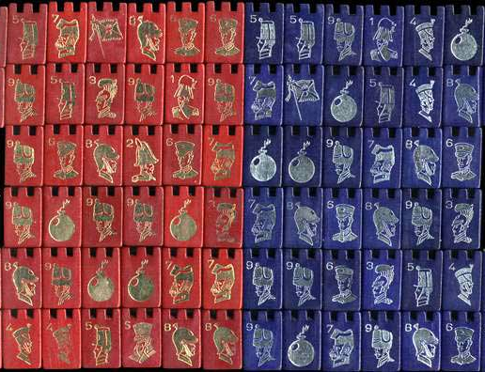
Notes:
There are lots of pieces in the original game…

Slide 23
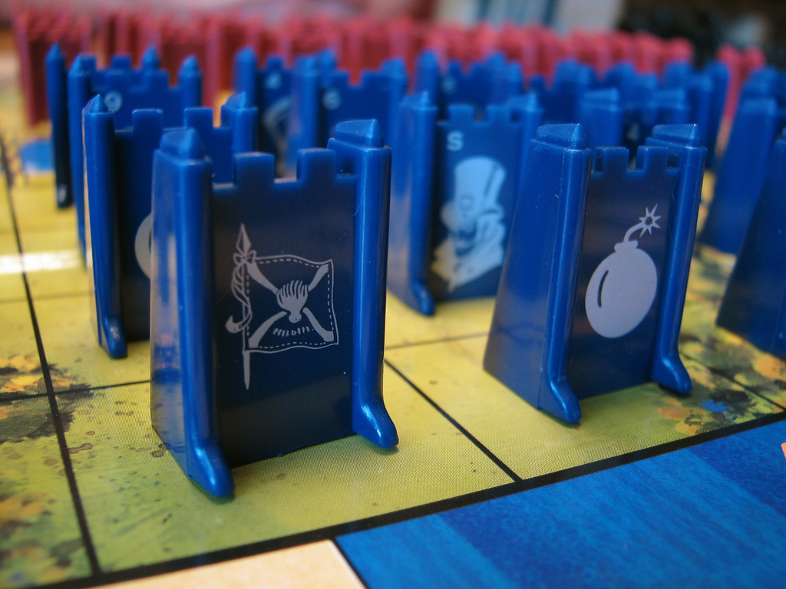
Notes:
But in this talk, we’re going to pretend that the only pieces are flags and bombs. If you hit a flag, you win. If you hit a bomb, you die.

Slide 24
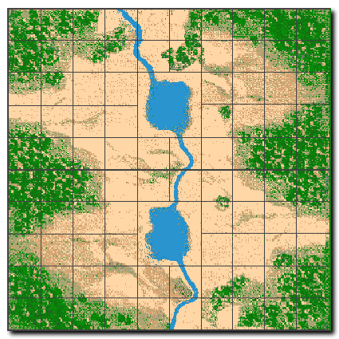
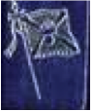
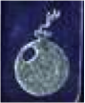
Notes:
Suppose this is the board layout.

Slide 25
Notes:
If the attacker hits the flag, …

Slide 26
Notes:
Pwned.

Slide 27
Notes:
However…

Slide 28
Notes:
If he hits the bomb...

Slide 29
Notes:
Then “the good guys” win.

Slide 30
Notes:
So to be concrete…

Slide 31
sensitive data / metadata
Notes:
The flags are sensitive data or metadata.

Slide 32
sensitive data / metadata
All data / metadata sensitive
Notes:
In our model, we assume conservatively that *all* data / metadata is sensitive.

Slide 33
guard / unmapped page
Notes:
And each bomb is either a guard page (mprotected) or an unmapped page, so a write or read into this space…

Slide 34
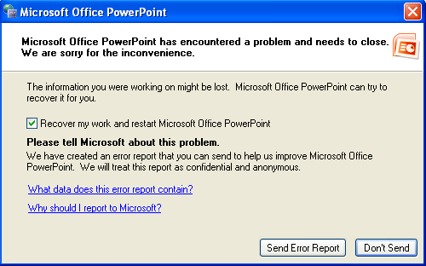
guard / unmapped page
Notes:
Does this.

Slide 35

Notes:
This is how it works for Windows

Slide 36
Notes:
This is how it works for Windows

Slide 37
Notes:
This is how it works for Windows

Slide 38
Address-space layout randomization
Notes:
This is how it works for Windows

Slide 39
object
free space
heap metadata

Slide 40
prev. object
object size
object
free space
heap metadata
(GNU libc, others)

Slide 41
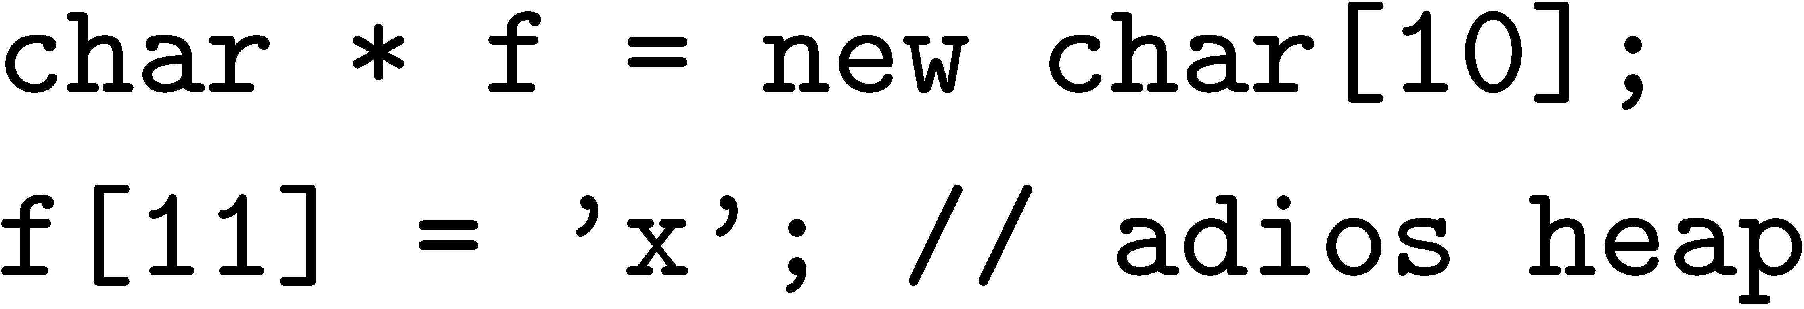
object
x
free space
heap metadata

Slide 42
object
x
free space
heap metadata

Slide 43
Notes:
This is how it works for Windows

Slide 44
Notes:
This is how it works for Windows

Slide 45
Notes:
This is how it works for Windows

Slide 46
Notes:
This is how it works for Windows

Slide 47
Notes:
This is how it works for Windows

Slide 48
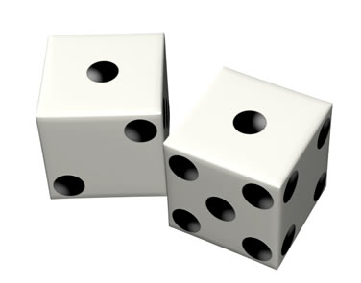
DIE HARDER
Notes:
This is how it works for Windows

Slide 49
Maximal entropy: log N bits (e.g., ≈ 25-30)
DIE HARDER
Notes:
This is how it works for Windows

Slide 50
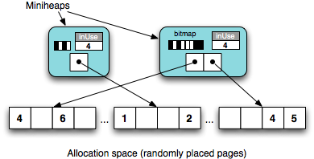

Slide 51

DIE HARDER

Slide 52
44.2 sec
DIE HARDER

Slide 53
44.2 sec
41.6 sec
DIE HARDER

Slide 54
DieHarder: Securing the Heap
www.cs.umass.edu/~emery

